Slide 1
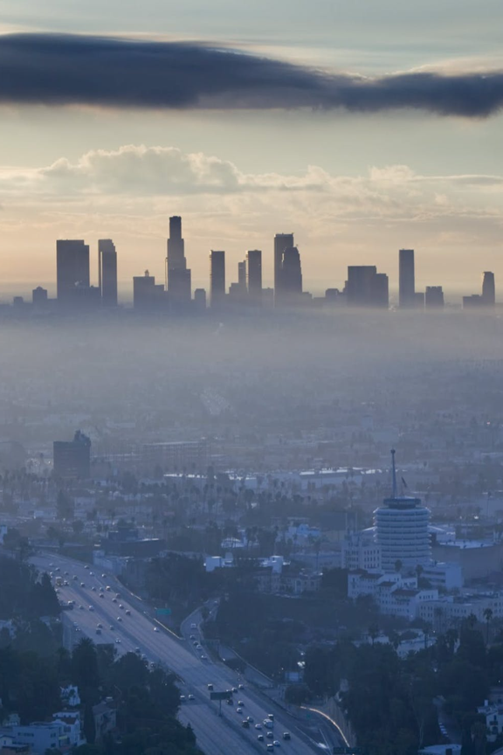
Pollution: An Overview
Pollution is the contamination of the environment that causes harm or discomfort to humans or other living organisms. It can have various sources and types, such as water, soil, marine, thermal, nuclear, and noise pollution.
By Tanmay kumar (2221114), Taranpreet Manko (22211115)

Slide 2
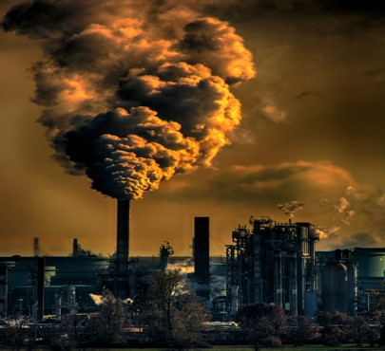
Environmental Pollution
Definition
Environmental Pollution can be defined as any undesirable change in physical, chemical, or biological characteristics of any component of the environment i.e. air, water, soil which can cause harmful effects on various forms of life or property.
1
.

Slide 3
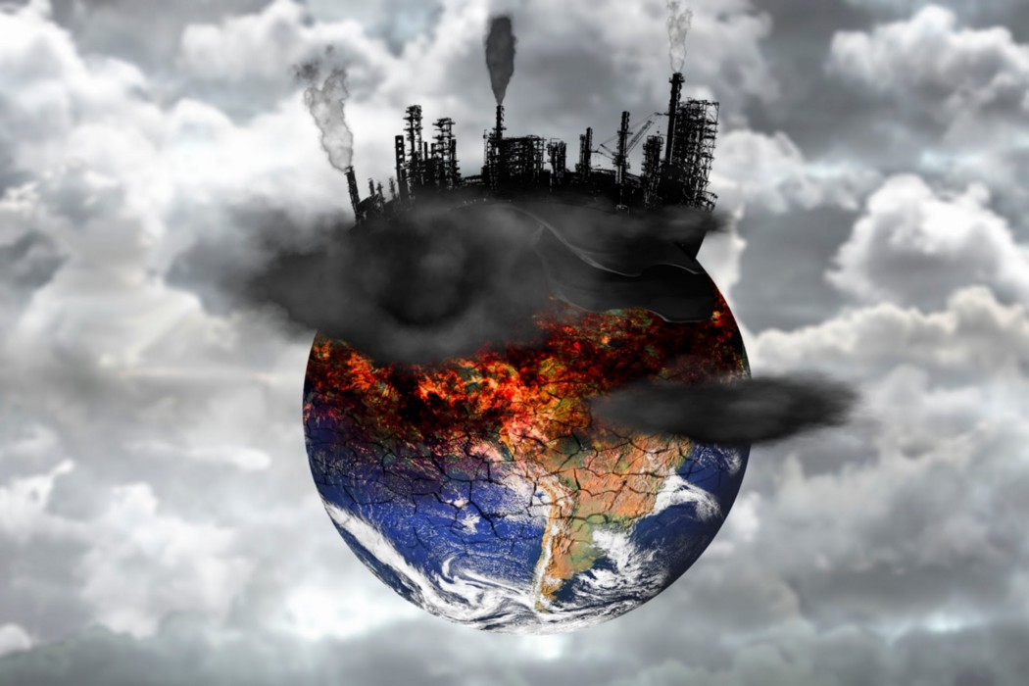
Effects
Environmental pollution has far-reaching consequences, such as climate change, biodiversity loss, respiratory diseases, contaminated water sources, and degraded soil quality.
Causes
Various factors contribute to environmental pollution, including industrial activities, improper waste disposal, deforestation, vehicular emissions, and the burning of fossil fuels

Slide 4
TYPES OF POLLUTION
SOIL POLLUTION
NOISE POLLUTION
MARINE POLLUTION
THERMAL POLLUTION
NUCLEAR HAZARDS

Slide 5
Soil Pollution
1
Contaminants
Soil pollution results from improper waste disposal, agricultural activities, industrial contaminants, and pesticide use, degrading soil fertility and impairing plant growth.
2
Impact on Food Chain
Contaminated soil affects the food chain by accumulating toxins in plants, leading to contaminated crops and potential health risks for animals and humans.
3
Remediation Techniques
Remediation methods include soil remediation technologies, sustainable farming practices, and soil conservation programs to restore soil health and protect agricultural productivity.

Slide 6
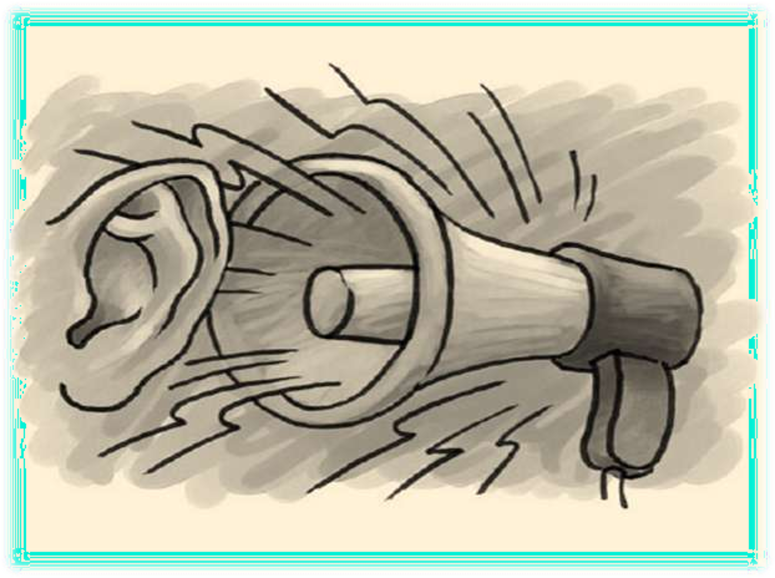
NOISE POLLUTION
Noise pollution is excessive, displeasing
human, animal, or machine-created environmental noise that disrupts the activity or balance of human or animal life.
Sound becomes undesirable when it disturbs the normal activities such as working, sleeping, and during conversations.
World Health Organization stated that “Noise must be recognized as a major threat to human well- being”

Slide 7
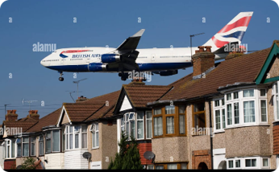
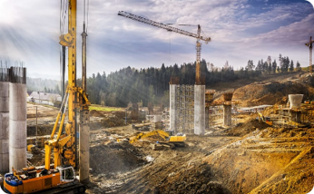
Source of Noise Pollution:
Transportation Noise
Construction Sites
Music
Noise from airplanes, cars, and trains causes hearing problems, sleep disturbances, and other health issues.
Construction equipment and tools generate loud and disturbing noises, causing difficulty in sleeping and psychological discomfort
Excessive exposure to loud music and other entertainment noise sources can cause hearing and psychological problems

Slide 8
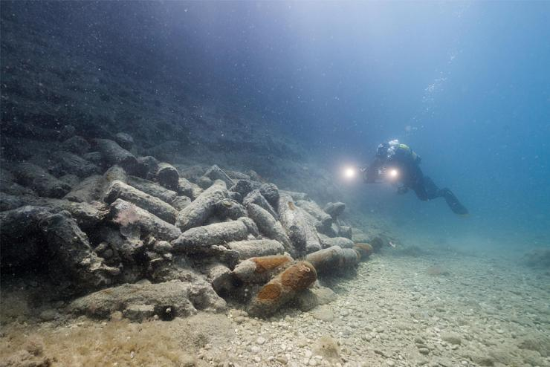
Marine Pollution
1
Sources of Pollution
2
Ecosystem Degradation
Marine pollution stems from oil spills, plastic waste, chemical runoff, sewage disposal, and overfishing, posing severe threats to marine life and ecosystems.
Marine pollution disrupts delicate ecosystems by harming corals, causing algal blooms, endangering marine species, and impairing the overall health of oceans and seas.
3
Conservation and Restoration
Conservation efforts involve implementing effective waste management practices, promoting sustainable fishing methods, and establishing marine protected areas.

Slide 9
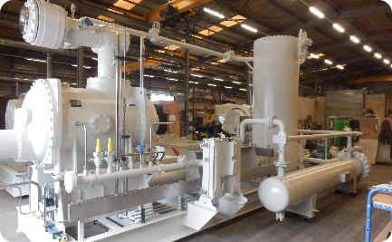
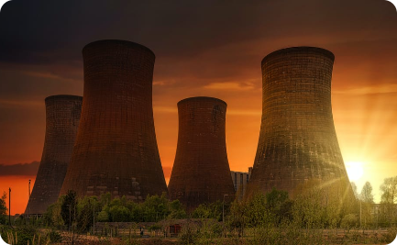
Thermal Pollution
Industrial Heat Discharge
Cooling Technologies
Mitigation Strategies
Cooling technologies like cooling towers and heat exchangers help reduce thermal pollution by dissipating heat and maintaining suitable water temperatures.
Mitigation strategies include using alternative energy sources, improving cooling system efficiency, and implementing environmental impact assessments.
Thermal pollution occurs when industrial processes release excessive heat into water bodies, leading to drastic temperature changes and negatively affecting aquatic life.

Slide 10
Nuclear Hazards
Risk of Nuclear Accidents
Radioactive Waste Management
Nuclear Energy Regulation
Nuclear accidents, like Chernobyl and Fukushima, release hazardous radioactive materials into the environment, causing long-term health effects and environmental contamination.
Safe storage and disposal of radioactive waste are crucial to preventing potential leaks, contamination, and radiation exposure to humans and the ecosystem.
Stringent regulations, standardized safety protocols, and rigorous monitoring are essential to mitigate the risks associated with nuclear energy production.

Slide 11
Conclusion: Acting to Protect Our Environment
Individual Responsibility
Explore ways in which individuals can contribute to reducing pollution and promoting environmental stewardship.
Collective Actions
Discuss the importance of political, corporate, and societal efforts to address pollution issues and create a sustainable future.
Hope for the Future
Highlight inspiring success stories and ongoing initiatives that offer hope for a cleaner and healthier environment.

Slide 12
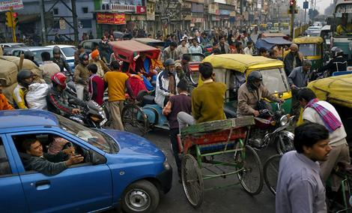
Case study of New Delhi
LOUDEST CITY IN INDIA
Back in 2011, a study by the Centre of Science and Environment (CSE) has confirmed that New Delhi is the loudest city in India. The level of noise in the streets can go above 100 decibels, which is several times louder than Singapore. The noise level has reached dangerous levels, beyond the recommended guidelines of 50-55 decibels for residential zones. Prolonged exposure to this level of noise has resulted in the increase of risk in hearing loss for the citizens. According to studies, the average age of citizens in New Delhi are 10 years older in terms of hearing, which means they are at greater risk of losing their hearing in their 50s or early 60s.

Slide 13
The loud noise is often generated by the honking of cars, which means changes in attitude and behavior can reduce the main source of the noise. However, this is a hurdle as the habit of honking is ingrained into their daily routine. The streets of New Delhi are shared by vehicles, people, cyclists and more. Traffic is very heavy and the use of honk is essential to alert people walking on the street of an oncoming vehicle. As this concerns personal safety, the honking behavior will be a strong internal barrier as the drivers cannot simply stop honking.

Slide 14
Thank you

